Slide 1


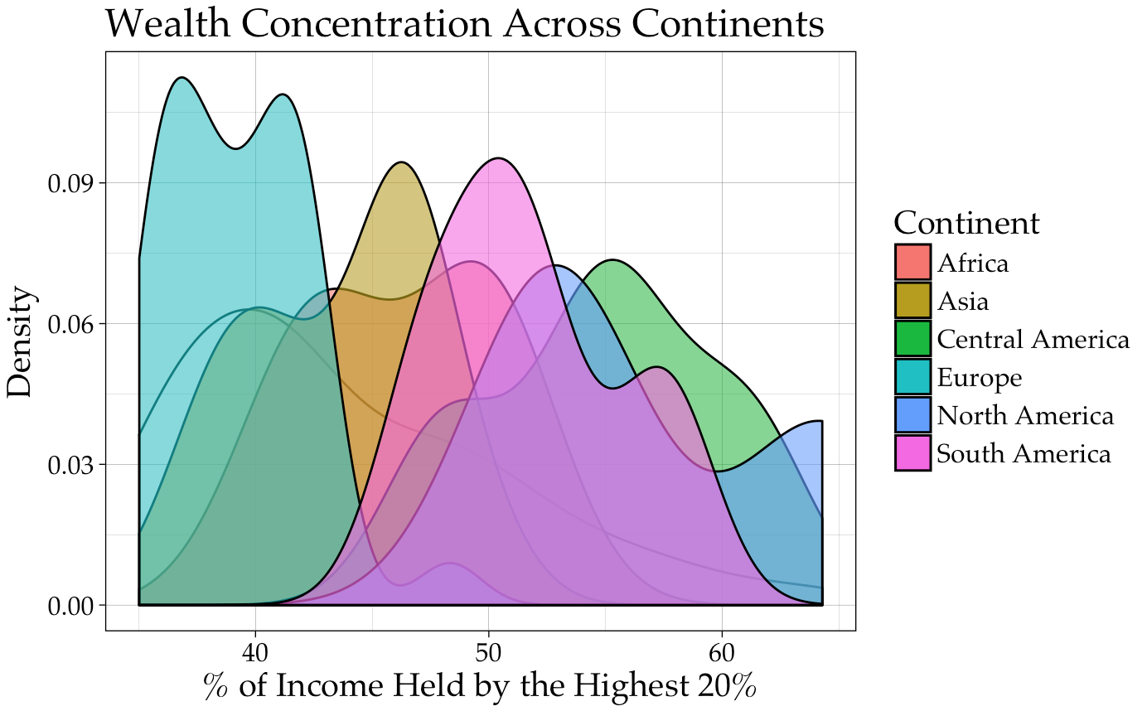
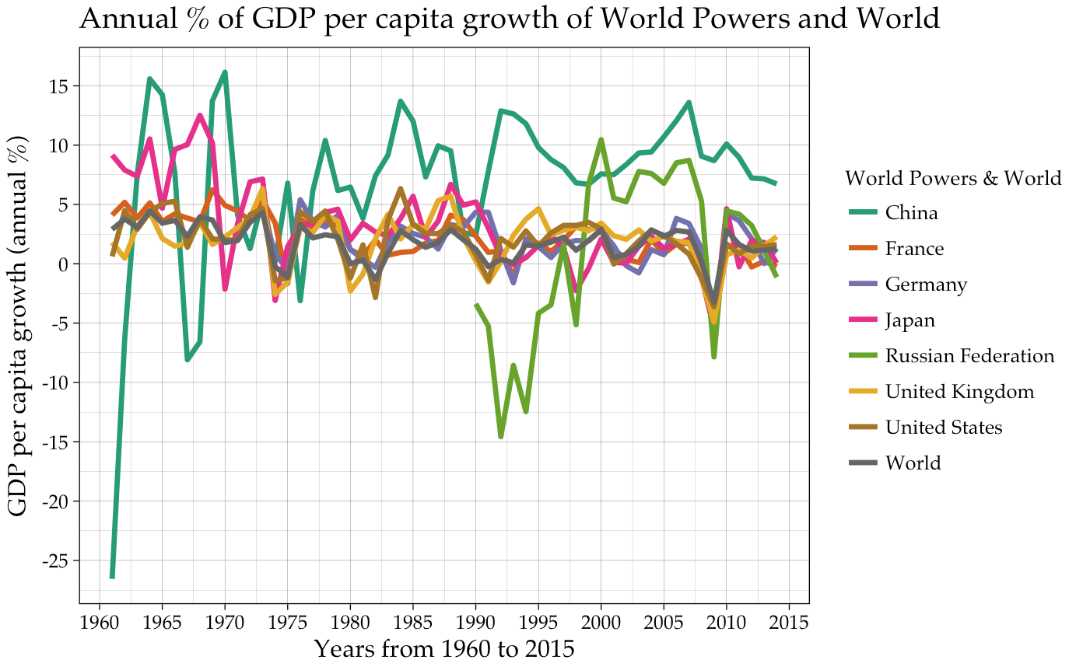
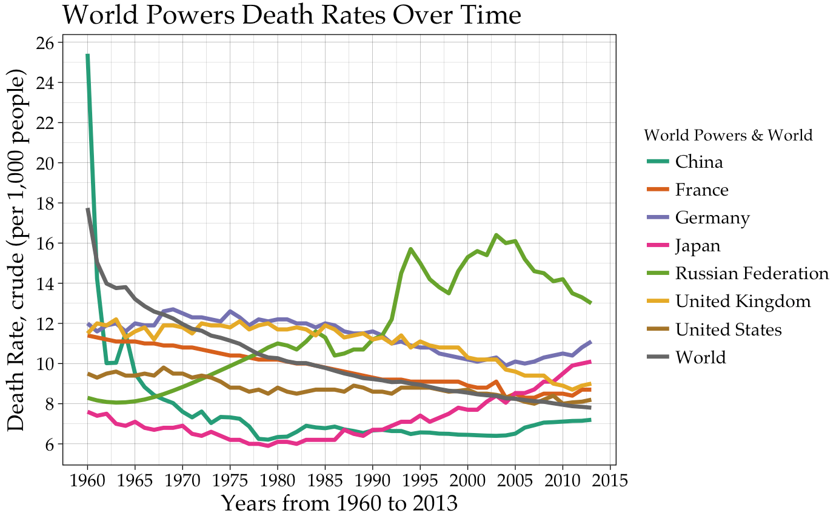
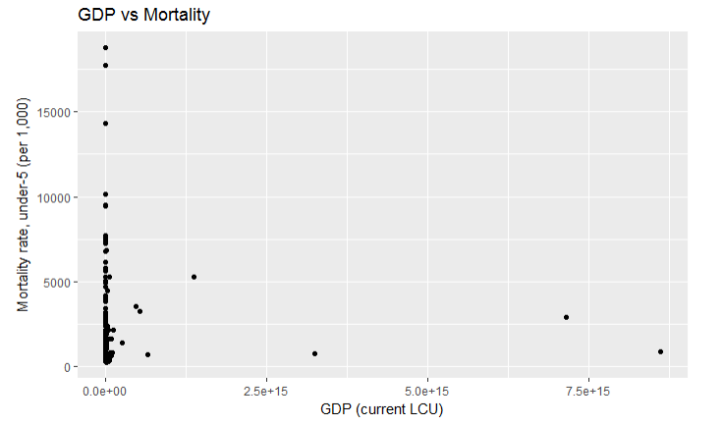
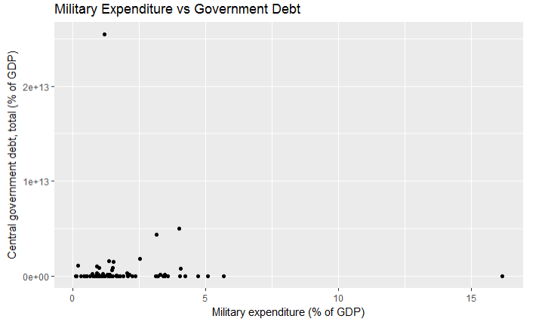
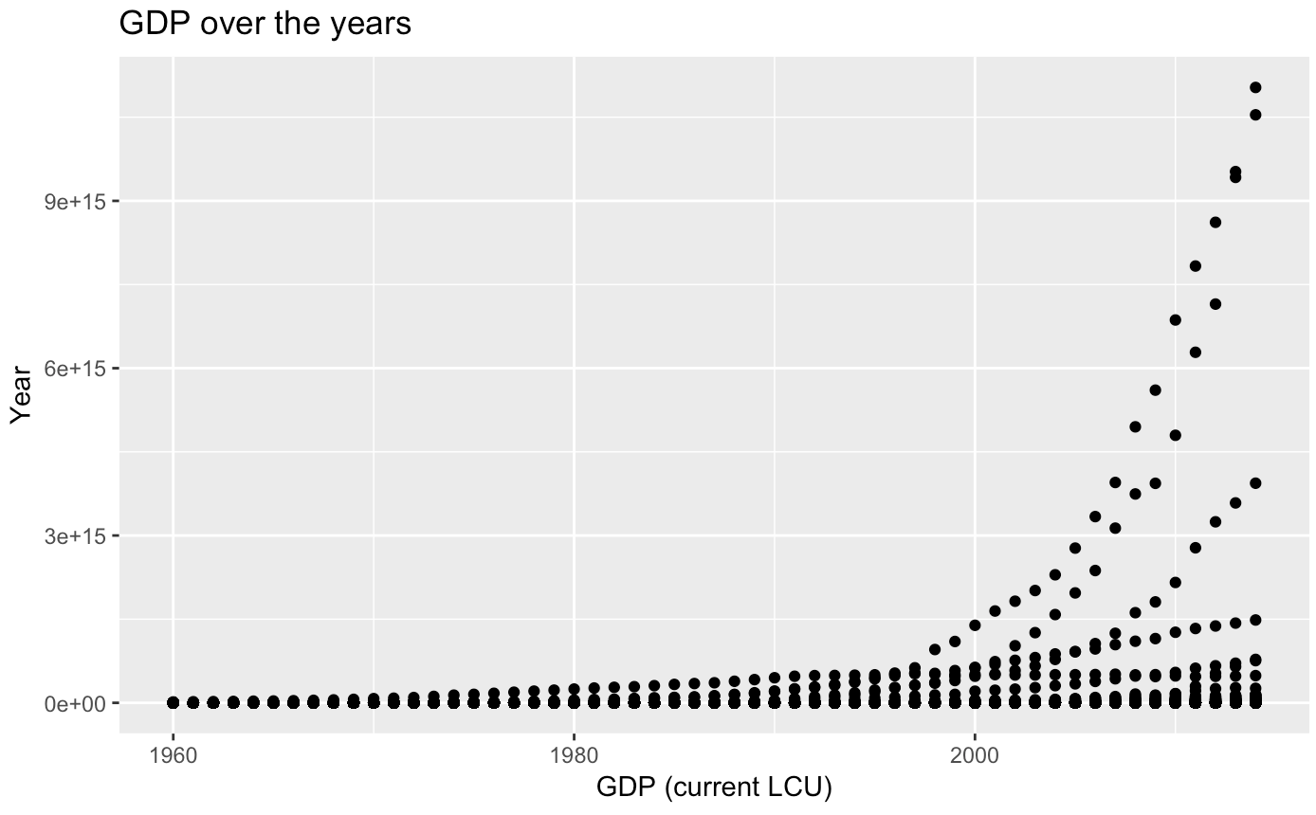
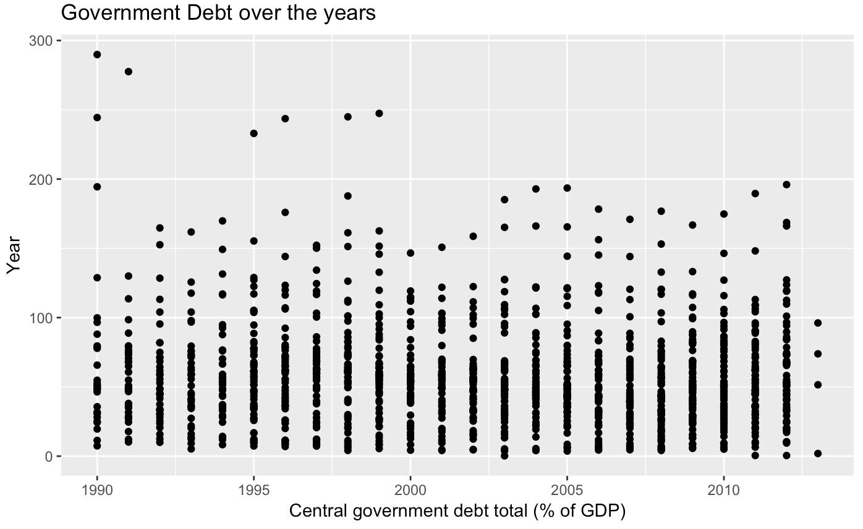
Exploring The World’s Major Powers
Julien Naegeli, Alex Frazier, Maria Rodriguez, and Johnny Wu
Dataset:
The World Development Indicators is a dataset consisting of 247 countries and 1,344 indicator variables relating to the development of each country. We have taken a subset of this dataset that includes the variables we find most interesting to the description of the world’s powers. These variables include: GDP, Military Expenditure, Mortality Rates, Literacy Rates, Amount of Exports / Imports, Population size, Corruption, and more. The countries that we consider to be world powers are the United States, United Kingdom, China, Japan, Germany, France, and Russia. We wish to show as many relationships as we can between these variables and countries in order to show what separates these countries from the rest of the world
Wealth Concentration
WorlD’s Life Expectancy
GDP WorlDwide
Life expectancy & GDP
There is a clear distinction of the major powers from the rest of the world in life expectancy. This interesting graphic shows the intense disparities in life expectancy across the world,
In contrast with the life expectancy map, the GDP map shows that the countries with the smallest GDP also have a very low life expectancy whereas the countries with the largest GDP have higher life expectancy.
We can use this information to further infer our descriptions of the world powers as powerful, healthy, and economically stable countries.
Wealth Concentration & Dendrogram
Clusters & Continents
GDP Growth and Death Rate OVER Time
The Wealth Concentration Density Plot (above) represents the wealth held by the top 20% in each continent. Each density curve corresponds to an aggregate of the countries that lie within each continent. The graph shows that Central America and North America have the largest concentration of countries where the highest shares of the wealth are being held by the top 20%.
The graph to the right is a Dendrogram of Countries based on the continuous variables of Unemployment Rate, GDP, Military Expenditure, Life Expectancy at Birth, and Exports of Goods and Services. The World Powers are colored in yellow. The Dendrogram splits them into two groups with Germany, China and the US in one group and France, Japan, Russia, and the UK in the other group. It seems that within each group, those countries are more similar to each other than to the countries in the other group.
The Annual GDP Per Capita Growth Rate of the World Powers and the World is graphed to the left. Most of the World Powers seem to follow the trend of the world regarding growth. Over time they mostly reside in a range between 0 and 5. China and the Russian Federation, and to a slightly less degree Japan seem to be outliers with China starting at a -25% growth rate and Japan and China both spring to 10-15% around the 1960s and 1970s.
The Death Rate over Time is graphed to the bottom.
Johnny
This graph shows Mortality rate of those 5 and under versus GDP of the country. It seems that as GDP rises, the mortality rate tends to decrease.
This graph shows Military Expenditure versus Debt of the country. It seems that as Expenditure rises, the Debt rate tends to rise, with some outliers.
Johnny graph

